Slide 1
A Comparison of statistical modeling approaches for hierarchical data: a simulation study and application to ecology data
Jillian Hebert

Slide 2
Introduction
Investigate the differences in results when variables specification and model selections differ
Intricate and important part of many statistical analyses
Uninformed choices can inaccurately reflect the context of the data
Critiqued and rejected publications
Variable specification
Fixed effects – comparing means of levels (i.e. teaching method)
Random effects – variation across level (i.e. classroom)
Four models and four datasets

Slide 3
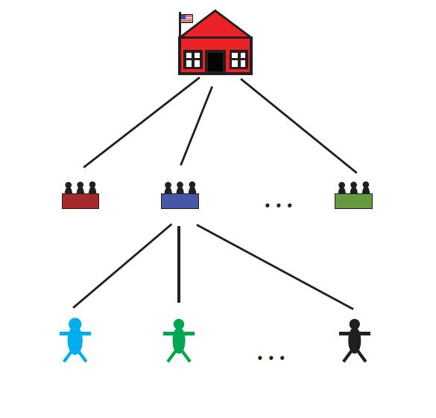
A comparison of statistical modeling approaches for hierarchical data: A simulation study and application to ecology data

Slide 4
Background
Hierarchical designs
Experimental structure where treatment and experimental units are sub-sampled
Nested design
6 tanks with 50 fish in every tank
Random: Tank with fish nested in tank
Mixed Effects Models
Models that include fixed and random effect terms
Allows for random effect estimations
Useful for data structures with repeated measures

Slide 5
Pooled Model
Complete data pooling over random effect term
Ex: Pooled the measurements from fish by tank
Loss of variation information

Slide 6
Fixed Model
Fits all terms as fixed effects
Artificial inflation of sample size
Includes negligible terms unimportant to objectives

Slide 7
Maximum Likelihood (ML) Model
Maximizes log likelihood function
Minimizes the residual sum of squares
Biased variance estimators

Slide 8
Restricted Maximum Likelihood (REML) Model
Maximizes log likelihood function
Unbiased variance estimators
Best linear unbiased prediction

Slide 9
Datasets
Simulated Datasets
Empirical Datasets
No treatment effect
Gamma distribution with skewness of 0.5
Treatment effect
Gamma distribution with skewness of 0.5
Treatment effect of 3 – half the standard deviation
Exposure Related Effects of Zequanox
Controls invasive mussels
Impacts on native species – Lake Trout & Lake Sturgeon
Skewness of 0.24
Acoustic Telemetry Evaluation of Carbon Dioxide
Impacts of CO2 on carp movement – Bighead & Grass Carp
Skewness of 0.46

Slide 10
Simulated Datasets

Slide 11
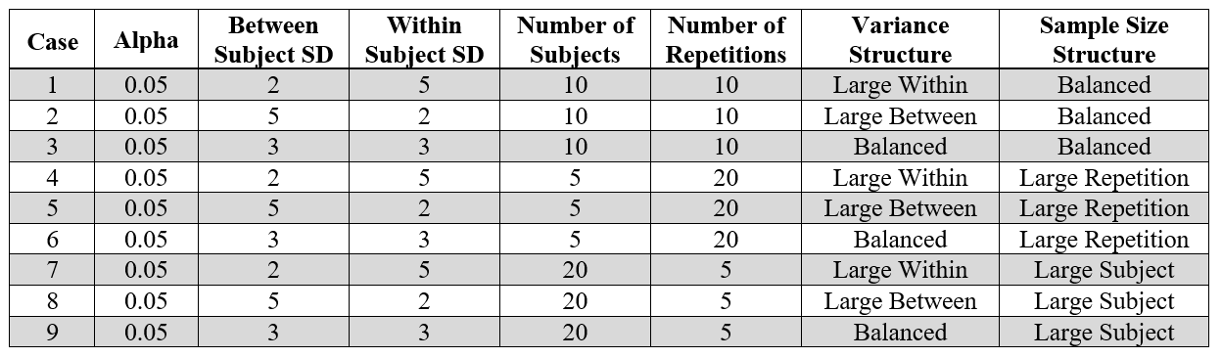
Purpose
Calculate estimated power of each model
Evaluate accuracy of estimates
Compare 95% confidence intervals

Slide 12
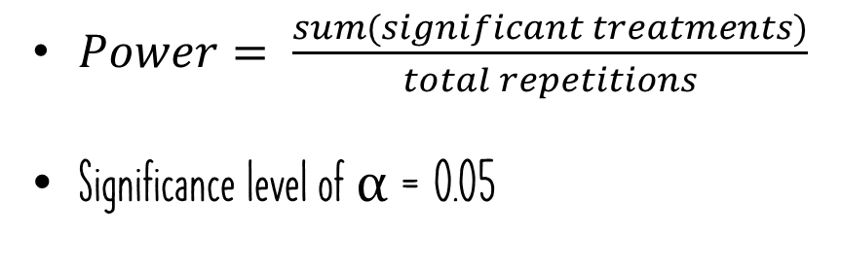
Methods
Determined data structure by case conditions
Paralleled a nested design structure
1,000 simulated samples
Significance value
Lower 95% confidence interval
Upper 95% confidence interval
$Power= \frac{sum(significant treatments)}{total repetitions}$
Significance level of α = 0.05

Slide 13
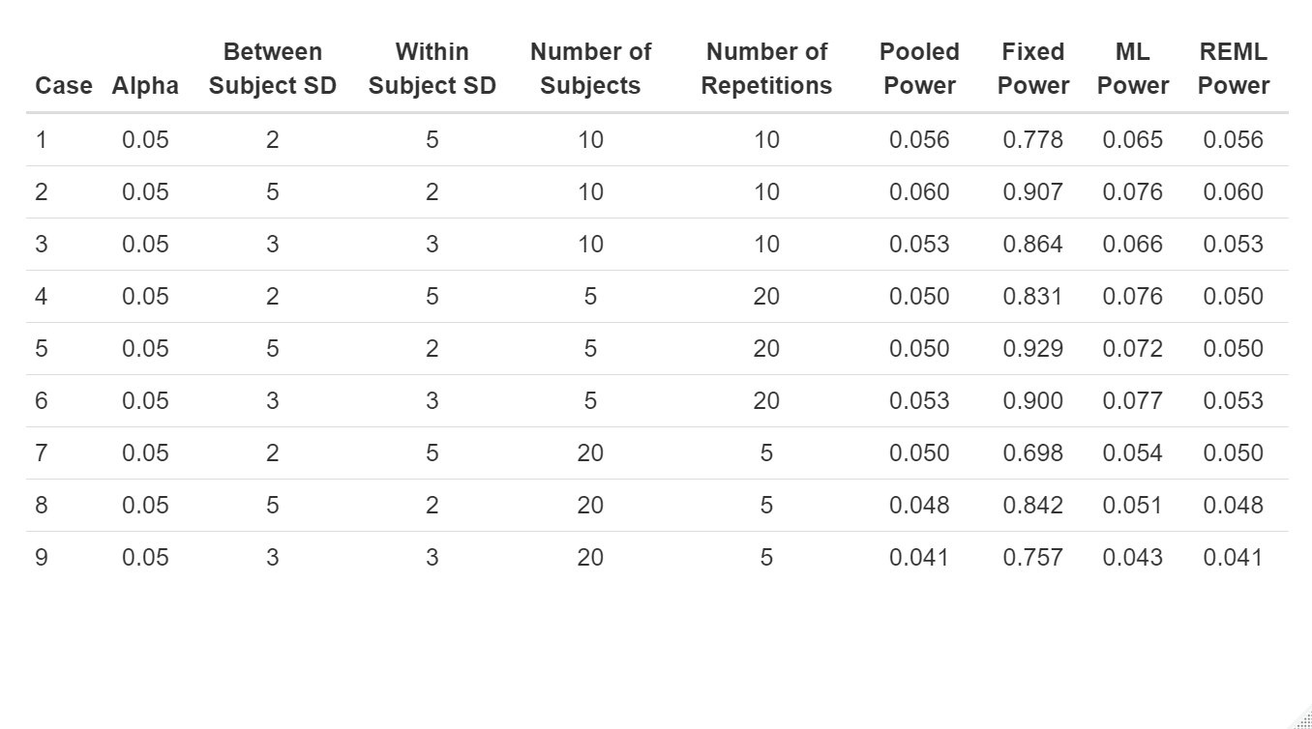
Results: No treatment Effect
Near 0.05
Extremely high fixed model power
Cases 7, 8, & 9
High number of subjects
Low number of repetitions

Slide 14
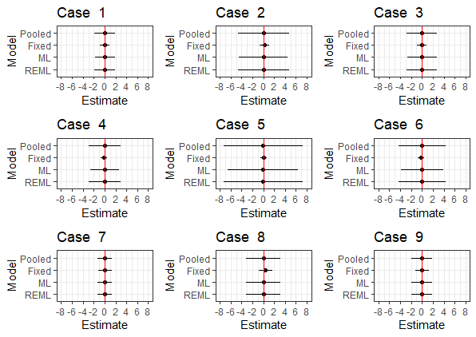
Confidence Intervals
95% interval for every model
Estimate centered at 0
Reference red line for center

Slide 15
No treatment effect Confidence Intervals
Cases 1 & 7
Large within subject standard deviation
Cases 5 & 6
High number of repetitions
Low number of subjects
Case 2
Large between subject standard deviation

Slide 16
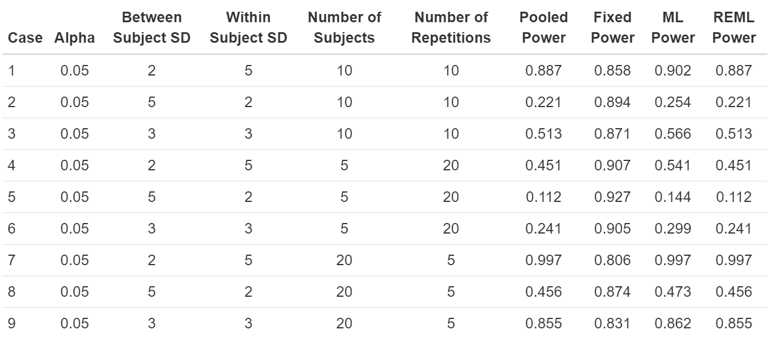
Results: treatment Effect
Higher powers indicate better fits
Cases 1 & 7
Large within subject standard deviation
Case 2 & 5
Large between subject standard deviation

Slide 17
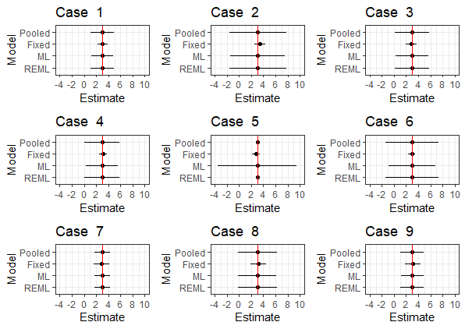
Treatment effect Confidence intervals
Centered at 3
Cases 1 & 7
Large within subject standard deviation
Cases 2 & 8
Large between subject standard deviation
Case 6
High number of repetitions
Low number of subjects

Slide 18
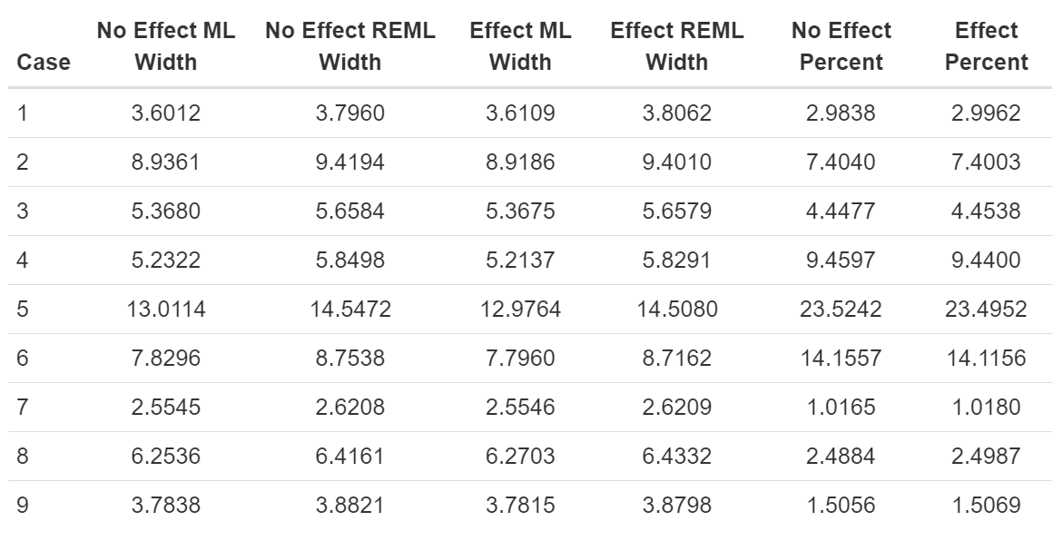
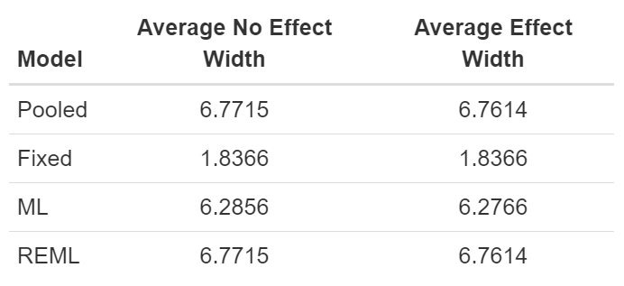
Comparisons
Identical outputs from pooled and restricted maximum likelihood models
Regression based model calculation
Similar widths
Uncertainty failed to be captured by fixed model
Tightest widths when there are a high number of subjects
4/20/2021

Slide 19
Empirical Datasets

Slide 20
Purpose
Compare significance values and confidence intervals
Special attention to degrees of freedom
Different variations of mixed effects model
Linear model (lm)
Linear mixed effects model (lme)
Significance level of α = 0.05

Slide 21
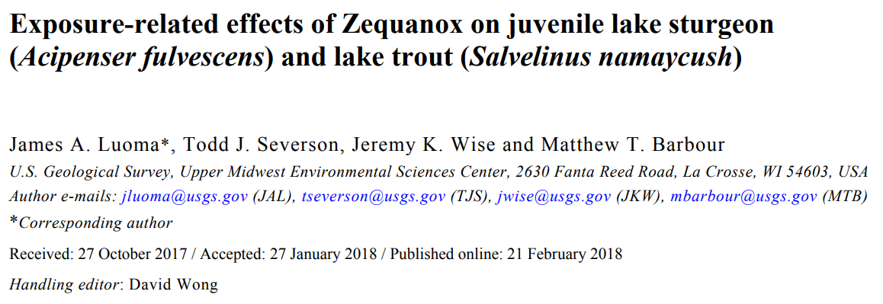

Slide 22
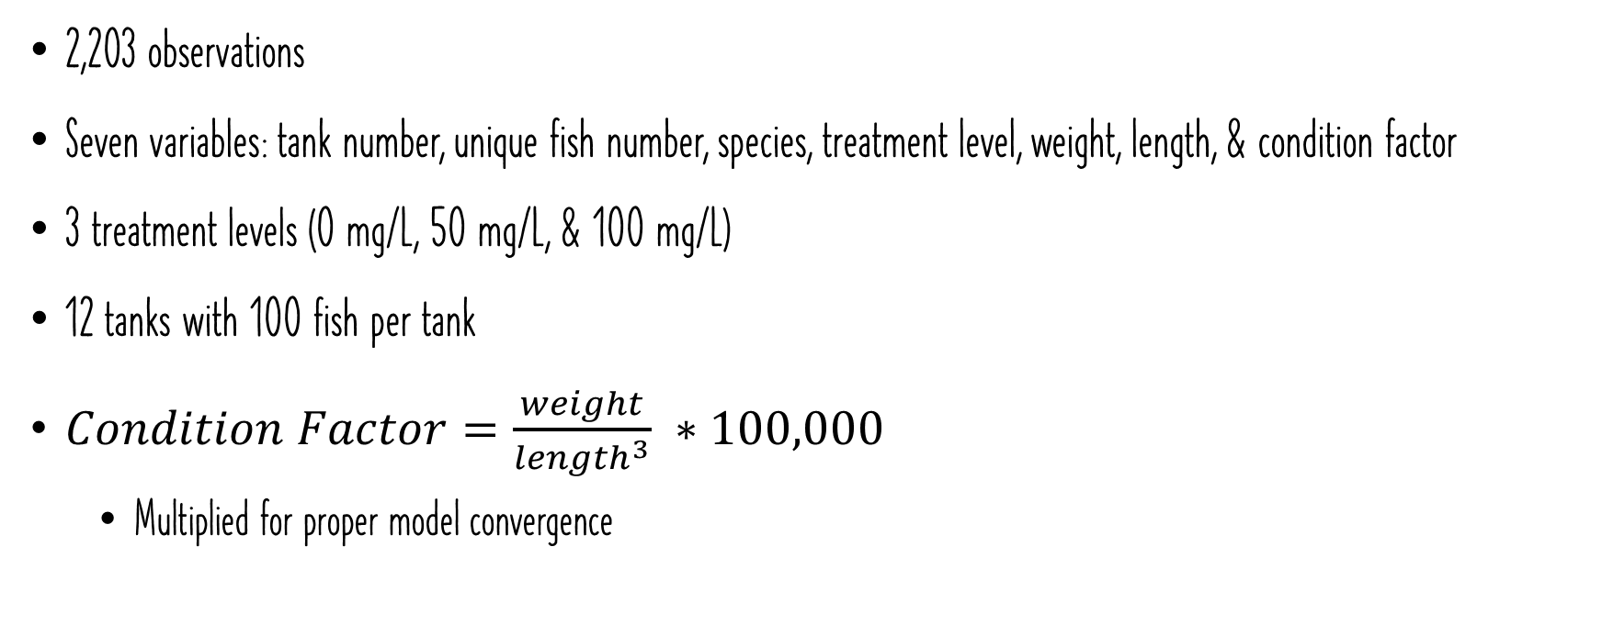
Methods
2,203 observations
Seven variables: tank number, unique fish number, species, treatment level, weight, length, & condition factor
3 treatment levels (0 mg/L, 50 mg/L, & 100 mg/L)
12 tanks with 100 fish per tank
$Condition Factor=\frac{weight}{{length}^{3}} ∗100,000$
Multiplied for proper model convergence

Slide 23
Models
Pooled Model (lm)
Fixed predictors: Treatment level & species
Response: Pooled condition factor
One response per tank per species
Fixed Model (lm)
Fixed predictors: Treatment level, species, & tank
Response: Original condition factor
Maximum Likelihood (ML) Model (lme)
Fixed predictors: Treatment level & species
Random predictors: Unique fish number nested in tank
Response: Original condition factor
Restricted Maximum Likelihood (REML) Model (lme)
Fixed predictors: Treatment level & species
Random predictors: Unique fish number nested in tank
Response: Original condition factor

Slide 24
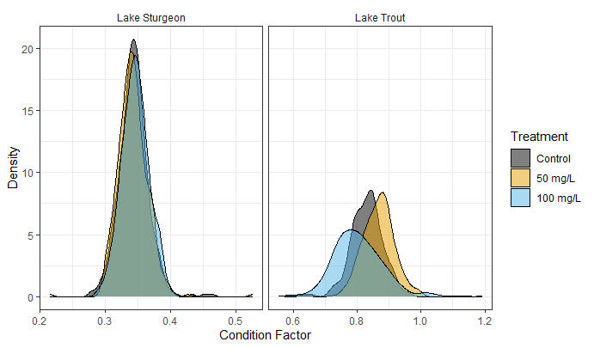
Descriptive Graphics
Higher condition factor for lake trout
Higher variation in lake trout

Slide 25
Results
Model | Intercept | Treatment 50 mg/L | Treatment 100 mg/L | Species Lake Sturgeon
Pooled | <0.0001** (0.8160 0.8468) | 0.0647 (-0.0012, 0.0366) | 0.2223 (-0.0303, 0.0075) | <0.001** (-0.5055, -0.4747)
Fixed | <0.0001** (0.8014, 0.8182) | 0.4129 (-0.0265, 0.0109) | 0.3037 (-0.0221, 0.0069) | <0.0001** (-0.4702, -0.4412)
ML | <0.0001** (0.8184, 0.8447) | 0.0440* (0.0005, 0.0349) | 0.2004 (-0.0283, 0.0063) | <0.0001** (-0.5045, -0.4763)
REML | <0.0001** (0.8171, 0.8460) | 0.0638 (-0.0011, 0.0365) | 0.2374 (-0.0300, 0.0079) | <0.0001** (-0.5058, -0.4749)
Significant differences in estimated condition factor for species
Significant difference found by maximum likelihood model

Slide 26
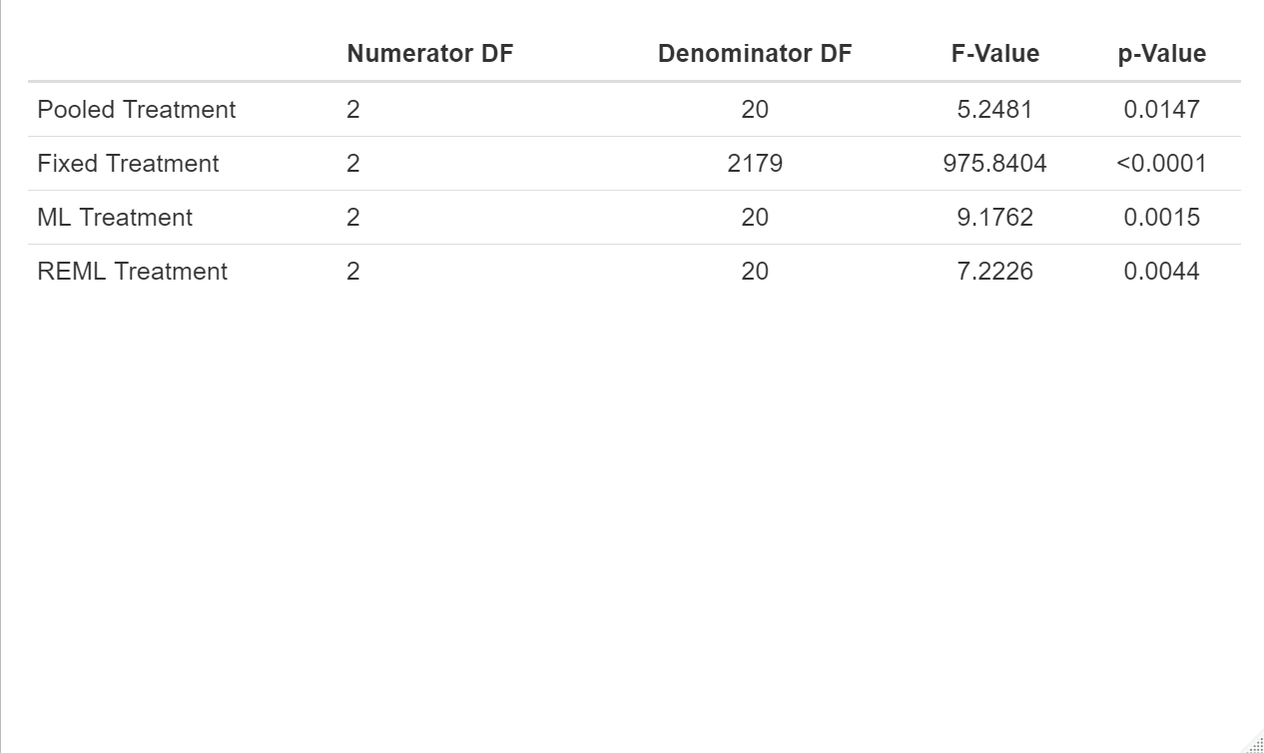
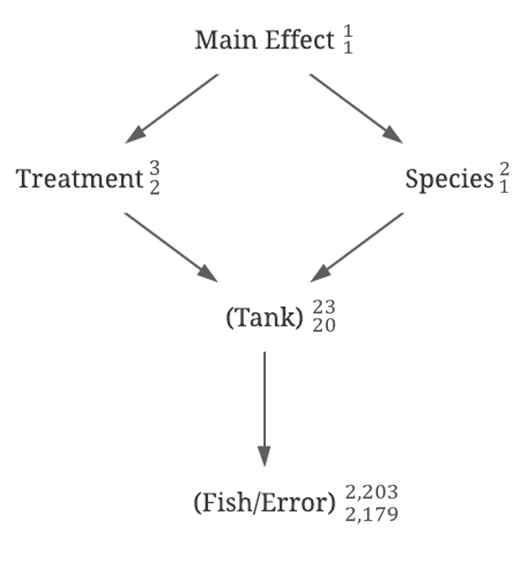
Comparisons
Incorrect denominator degrees of freedom for the fixed model
Increased significance

Slide 27
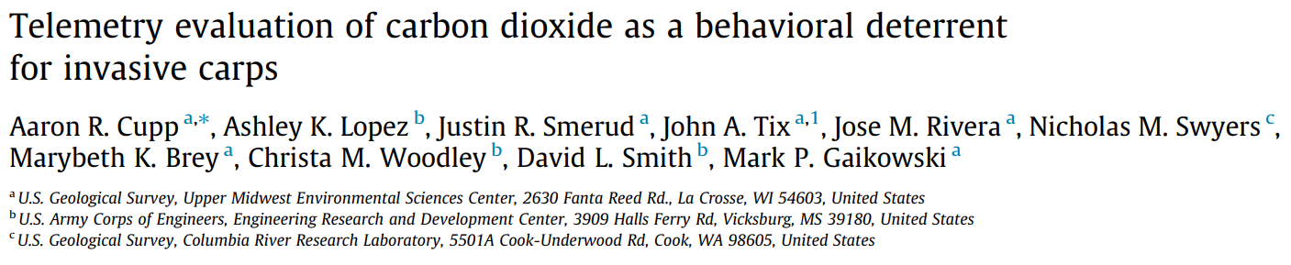

Slide 28
Methods
Over 2.5 million observations of fish movements about the pond
Applied adehabitatLT package to calculate absolute distance
Averaged absolute distance over a period for each fish
Separated species
86 observations for each species with repeated measures
Total crossings across the reference point
Summated over the period

Slide 29
Variables
Six variables: Trial, unique fish number, period, treatment level, treatment side, & absolute distance
9 trials
2 periods (acclimation & treatment)
3 treatment levels (low, medium, & high)
2 treatment sides (east & west)

Slide 30
Models
Pooled Model (lm)
Fixed predictors: Period, level, & treatment side
Response: Pooled absolute distance
One response per tank
Fixed Model (lm)
Fixed predictors: Period, level, period:level, & trial nested in level
Response: Original absolute distance
Maximum Likelihood (ML) Model (lme)
Fixed predictors: Period, level, treatment side, & period:level
Random predictors: Unique fish number nested in trial
Response: Original absolute distance
Restricted Maximum Likelihood (REML) Model (lme)
Fixed predictors: Period, level, treatment side, & period:level
Random predictors: Unique fish number nested in trial
Response: Original absolute distance

Slide 31
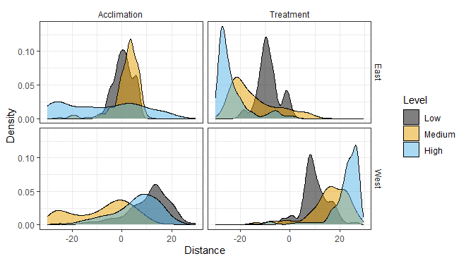
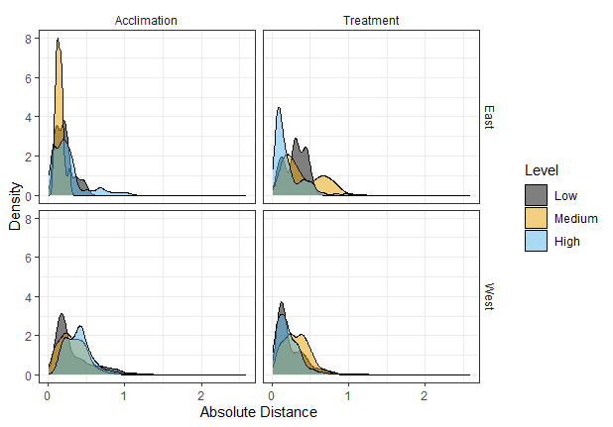
Distance Graphics
East side
Higher variation in the high treatment level during the acclimation period
Higher variation in the medium treatment level during the treatment period
West Side
High variation during the acclimation period
Higher variation in the medium treatment level during the treatment period
4/20/2021

Slide 32
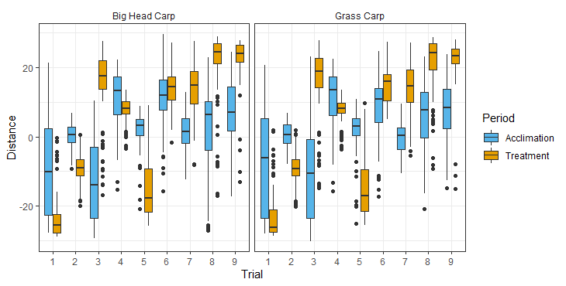
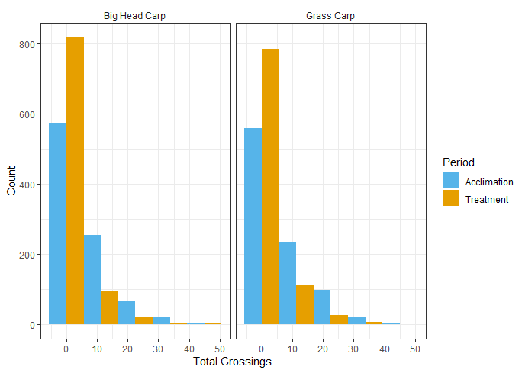
Descriptive Graphics
Large spread during the acclimation period
More crossings during the acclimation period
Species echo one another
A comparison of statistical modeling approaches for hierarchical data: A simulation study and application to ecology data

Slide 33
Bighead Carp

Slide 34
Results
Model | Intercept | Trtside West | Level Medium | Level High | Period Treatment | Level Medium: Period Treatment | Level High: Period Treatment
Pooled | 0.0049* (0.1217, 0.4021) | 0.1259 (-0.0303, 0.1817) | 0.4690 (-0.2395, 0.1276) | 0.6894 (-0.1533, 0.2138) | 0.7928 (-0.1638, 0.2033) | 0.3651 (-0.1590, 0.3601) | 0.2383 (-0.3948, 0.1244)
Fixed | <0.0001** (0.4413, 0.5279) | NA | <0.0001** (-0.2501, -0.1283) | <0.0001** (-0.2505, -0.1280) | 0.9438 (-0.0460, 0.0428) | 0.0115* (0.0185, 0.1420) | 0.0001** (-0.1936, -0.0680)
ML | <0.0001** (0.1618, 0.3743) | 0.2244 (-0.0549, 0.1960) | 0.5249 (-0.1917, 0.1085) | 0.5654 (-0.1129, 0.1880) | 0.9452 (-0.0457, 0.0426) | 0.0154* (0.0189, 0.1417) | 0.0002** (-0.1932, -0.0683)
REML | 0.0005** (0.1262, 0.4094) | 0.3325 (-0.0983, 0.2391) | 0.6168 (-0.2401, 0.1576) | 0.6452 (-0.1613, 0.2371) | 0.9439 (-0.0466, 0.0435) | 0.0133* (0.0176, 0.1429) | 0.0002** (-0.1945, -0.0671)
Significant differences in estimated absolute distance for treatment levels during treatment period
More significant differences for fixed model

Slide 35
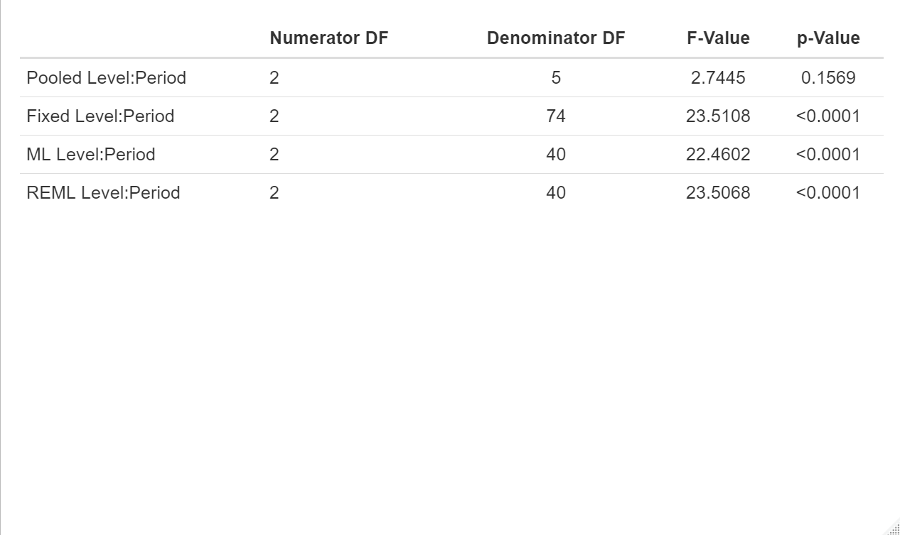
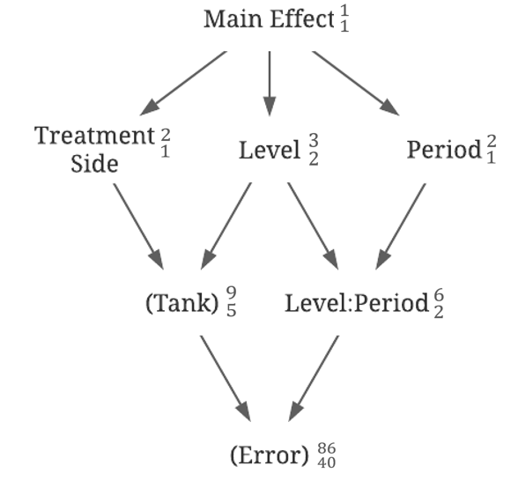
Comparisons
More significant differences for fixed model
Incorrect denominator degrees of freedom
Different conclusions for the pooled model
Repeated measures

Slide 36
Grass Carp

Slide 37
Results
Model | Intercept | Trtside West | Level Medium | Level High | Period Treatment | Level Medium: Period Treatment | Level High: Period Treatment
Pooled | 0.0080* (0.1053, 0.4244) | 0.2212 (-0.550, 0.1862) | 0.4496 (-0.2755, 0.1423) | 0.6534 (-0.1701, 0.2477) | 0.8728 (-0.2226, 0.1952) | 0.2588 (-0.1490, 0.4418) | 0.4466 (-0.3903, 0.2005)
Fixed | <0.0001** (0.4574, 0.5581) | NA | <0.0001** (-0.3020, -0.1598) | <0.0001** (-0.2760, -0.1324) | 0.0569 (-0.0991, 0.0015) | 0.0002** (0.0678, 0.2100) | 0.0463* (-0.1488, -0.0013)
ML | <0.0001** (0.1717, 0.3975) | 0.2789 (-0.0674, 0.1985) | 0.3305 (-0.2297, 0.0899) | 0.6747 (-0.1317, 0.1899) | 0.0658 (-0.0988, 0.0012) | 0.0005** (0.0682, 0.2095) | 0.0544 (-0.1484, -0.0017)
REML | 0.0004** (0.1348, 0.4334) | 0.3878 (-0.1126, 0.2437) | 0.4327 (-0.2805, 0.1407) | 0.7380 (-0.1823, 0.2405) | 0.0602 (-0.0998, 0.0022) | 0.0004** (0.0668, 0.2110) | 0.0494* (-0.1498, -0.0002)
Significant differences in estimated absolute distance for treatment levels during treatment period
More significant differences for fixed model

Slide 38
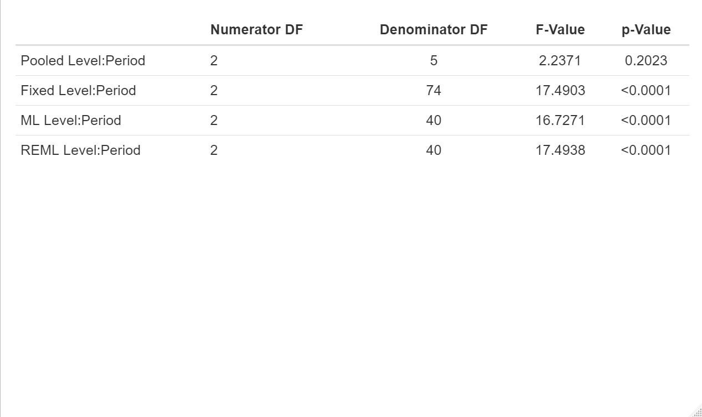
Comparisons
More significant differences for fixed model
Incorrect denominator degrees of freedom
Different conclusions for the pooled model
Repeated measures
Different conclusions for variables with borderline significances

Slide 39
Species Comparisons
Both pooled models found no significant differences
Both fixed models found all levels significantly different during both periods
Different conclusions for Bighead Carp & Grass Carp maximum likelihood models
Significant difference between low and medium level only for Grass Carp
Larger difference in absolute distance estimate for Grass Carp when moving from level low to medium
Both restricted maximum likelihood models found all levels significantly different during the treatment period
Larger difference in absolute distance estimate for Grass Carp when moving from level low to medium
Larger difference in absolute distance estimate for Bighead Carp when moving from level low to high
A comparison of statistical modeling approaches for hierarchical data: A simulation study and application to ecology data

Slide 40
Conclusions
Lower powers when the between subject standard deviation was large
Wider confidence intervals
Large between subject standard deviations
Higher numbers of repetitions
Lower numbers of subjects
Similar results from pooled and restricted maximum likelihood models
Regression based numerical methods
Denominator degrees of freedom varied for repeated measures
Variables handled inappropriately for fixed model
Increase in significant results
Negligible differences between maximum likelihood and restricted maximum likelihood models
Conclusions will differ when near the border of statistical significance
A comparison of statistical modeling approaches for hierarchical data: A simulation study and application to ecology data

Slide 41
Recommendations
Variable specification is important
Maximum Likelihood Model or Restricted Maximum Likelihood Model
Restricted Maximum Likelihood method for datasets with repeated measures
Data structure
Large within subject standard deviation
High number of subjects
Lower number of repetitions

Slide 42

Acknowledgments
Committee
Dr. Barbara Bennie
Dr. Richard Erickson
Mr. Aaron Cupp
UWL Mathematics and Statistics Department
Dr. Melissa Bingham
Dr. Robert Allen
Ms. Julie Ahearn

Slide 43
Questions?
A comparison of statistical modeling approaches for hierarchical data: A simulation study and application to ecology data

Slide 44
Reference Figures

Slide 45
Simulated Datasets

Slide 46
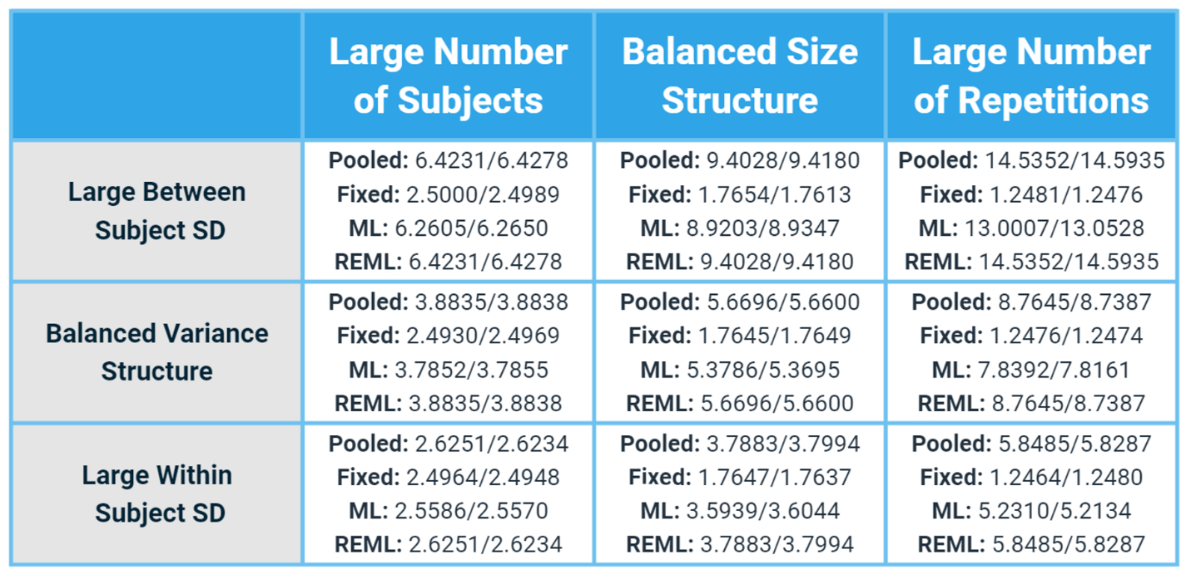
Confidence Interval Widths

Slide 47
Exposure Related Effects of Zequanox
Empirical Dataset from U.S. Geological Survey

Slide 48
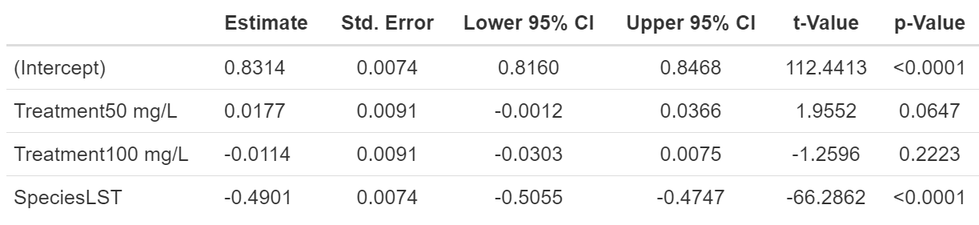
Pooled Model
Significant difference between species
Lake Trout had a higher pooled condition factor estimate than Lake Sturgeon
A comparison of statistical modeling approaches for hierarchical data: A simulation study and application to ecology data

Slide 49
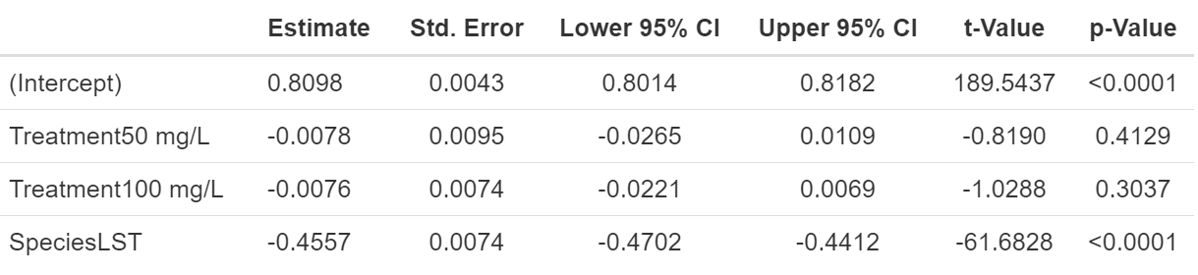
Fixed Model
Significant difference between species
Lake Trout had a higher condition factor estimate than Lake Sturgeon
Not all output shown
Note that LST is Lake Sturgeon
A comparison of statistical modeling approaches for hierarchical data: A simulation study and application to ecology data

Slide 50
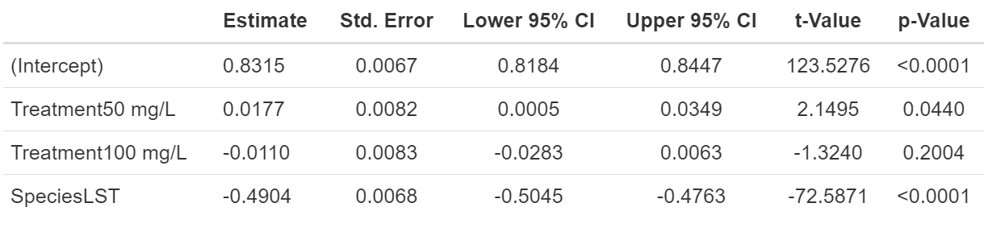
Maximum Likelihood (ML) Model
Note that LST is Lake Sturgeon
Significant difference between species
Lake Trout had a higher condition factor estimate than Lake Sturgeon
Significant difference control and 50 mg/L treatment
50 mg/L treatment had a higher condition factor estimate than the control treatment
A comparison of statistical modeling approaches for hierarchical data: A simulation study and application to ecology data

Slide 51
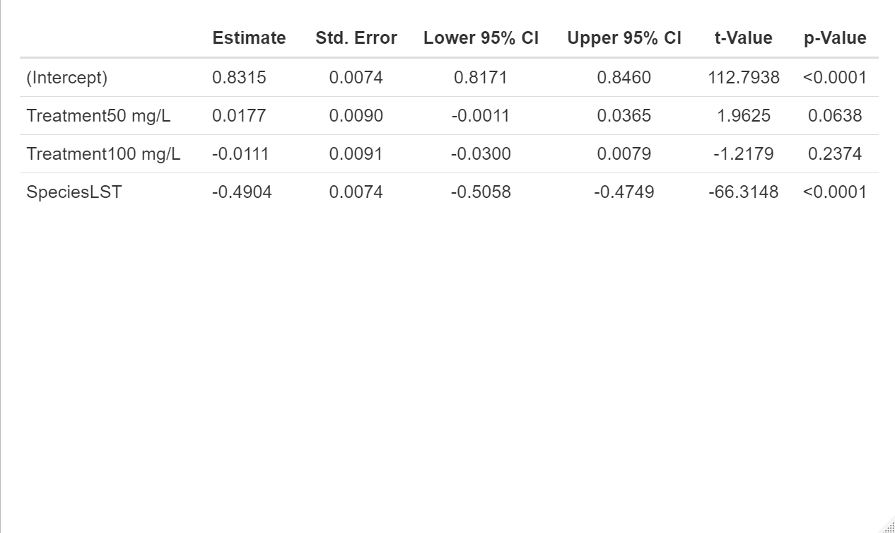
Restricted Maximum Likelihood (REML) Model
Significant difference between species
Lake Trout had a higher condition factor estimate than Lake Sturgeon
Note that LST is Lake Sturgeon
A comparison of statistical modeling approaches for hierarchical data: A simulation study and application to ecology data

Slide 52
Acoustic Telemetry Evaluation of Carbon Dioxide
Bighead Carp

Slide 53
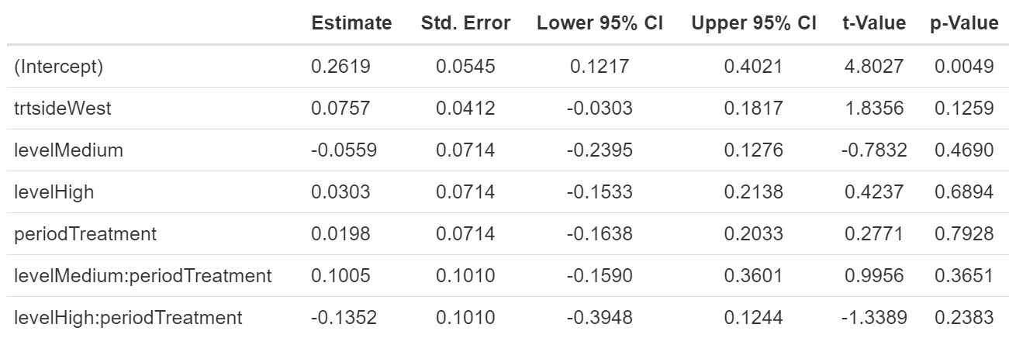
Pooled Model
No significant differences
A comparison of statistical modeling approaches for hierarchical data: A simulation study and application to ecology data

Slide 54
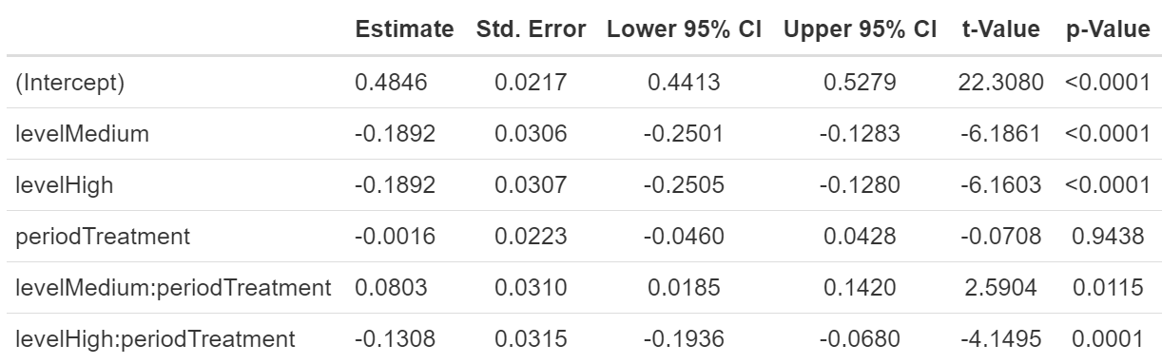
Fixed Model
Significant difference in absolute distance estimate for all levels during both periods
Not all output shown
A comparison of statistical modeling approaches for hierarchical data: A simulation study and application to ecology data

Slide 55
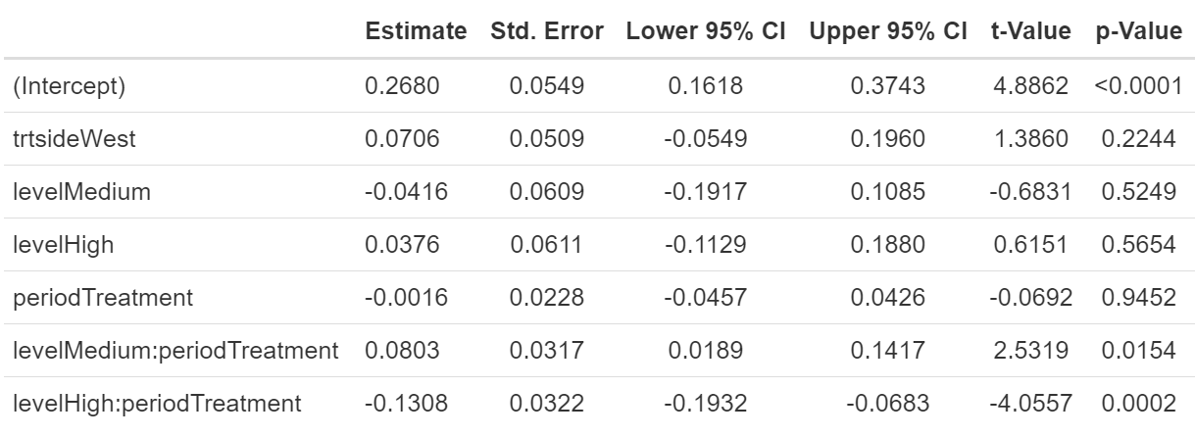
Maximum Likelihood (ML) Model
Significant difference between treatment levels during the treatment period
Low level had a lower absolute distance estimate than the medium level
Low level had a higher absolute distance estimate than the high level
A comparison of statistical modeling approaches for hierarchical data: A simulation study and application to ecology data

Slide 56
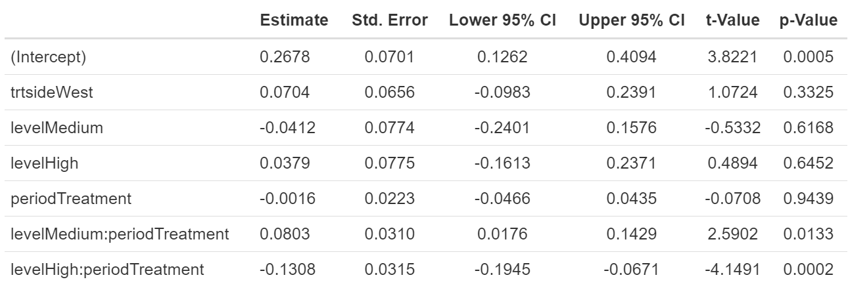
Restricted Maximum Likelihood (REML) Model
Significant difference between treatment levels during the treatment period
Low level had a lower absolute distance estimate than the medium level
Low level had a higher absolute distance estimate than the high level
A comparison of statistical modeling approaches for hierarchical data: A simulation study and application to ecology data

Slide 57
Acoustic Telemetry Evaluation of Carbon Dioxide
Grass Carp

Slide 58
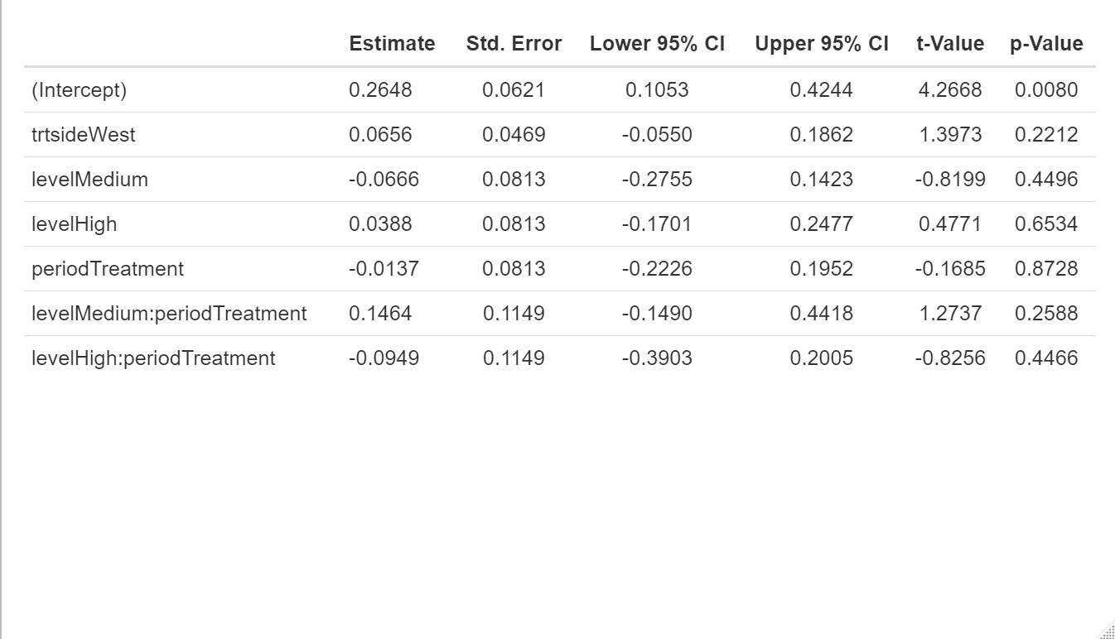
Pooled Model
No significant differences
A comparison of statistical modeling approaches for hierarchical data: A simulation study and application to ecology data

Slide 59

Fixed Model
Significant difference in absolute distance estimate for all levels during both periods
Close to having a significant difference between periods
Not all output shown
A comparison of statistical modeling approaches for hierarchical data: A simulation study and application to ecology data

Slide 60
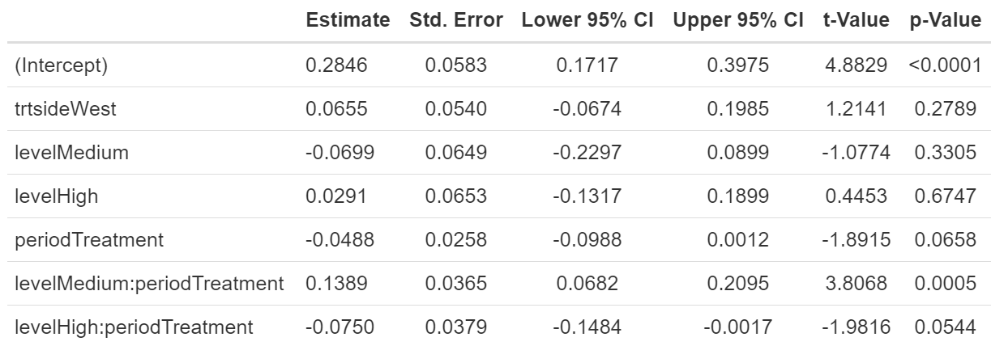
Maximum Likelihood (ML) Model
Significant difference between treatment levels during the treatment period
Low level had a lower absolute distance estimate than the medium level
A comparison of statistical modeling approaches for hierarchical data: A simulation study and application to ecology data

Slide 61

Restricted Maximum Likelihood (REML) Model
Significant difference between treatment levels during the treatment period
Low level had a lower absolute distance estimate than the medium level
Low level had a higher absolute distance estimate than the high level
A comparison of statistical modeling approaches for hierarchical data: A simulation study and application to ecology data

